Slide 1

AI Project-II (AI101B) Even Semester Session 2024-25
Language translation with sequence models
Devansh Batta 202410116100058
Anurag S. Kushwaha 202410116100039
Chitransha Bhatt 202410116100054
Bhavna Rajput 202410116100049
Project Supervisor:
Apoorv Jain
Ass. Professor

Slide 2
Content
Introduction
Literature Review
Objective of the Project
Technology Used
Modules
Workflow
Reports
References
Notes:
Font Styles: Times New Roman + Font Size: 25

Slide 3
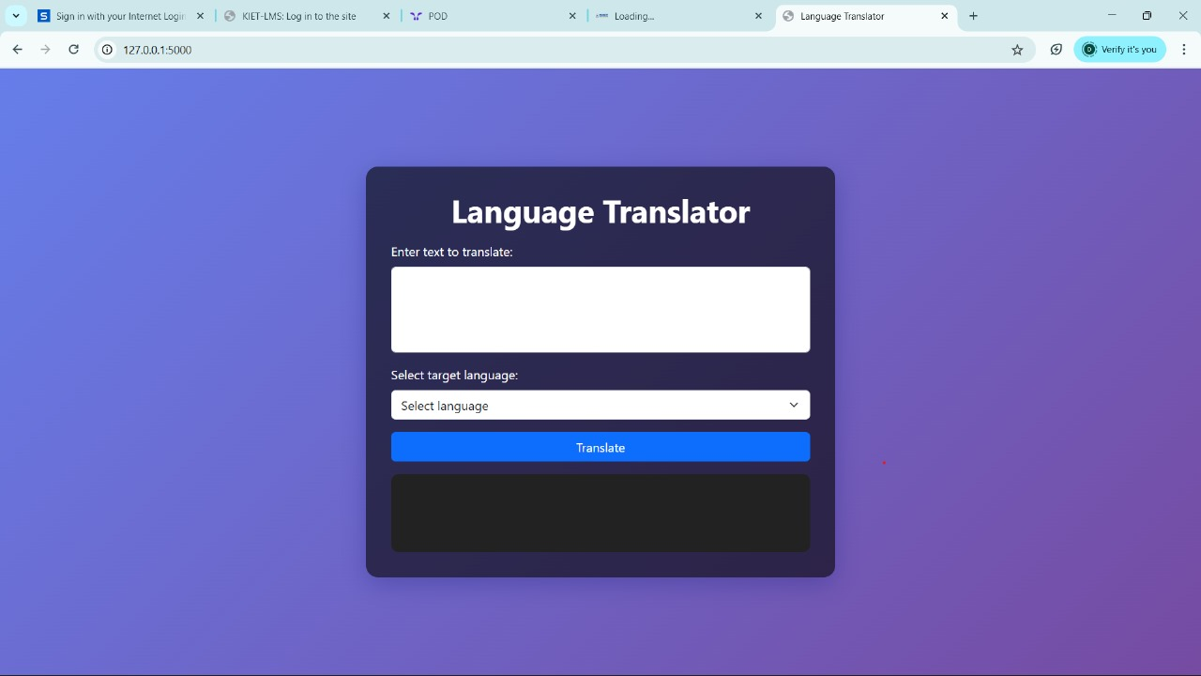
Introduction
A web-based application that enables real-time language translation using Flask and Hugging Face models.
It streamlines multilingual communication through a simple UI and robust backend.
Supports multiple languages for translation across various use cases.
Notes:
Font Styles: Times New Roman + Font Size: 25

Slide 4
Literature Review
Industry Overview: Growing demand for real-time translation in global communication.
Challenges in Traditional Systems: Dependence on external services, inconsistent performance, no offline models.
Existing Market Solutions: Google Translate, DeepL – powerful but not customizable or open-source.
Notes:
Font Styles: Times New Roman + Font Size: 25

Slide 5
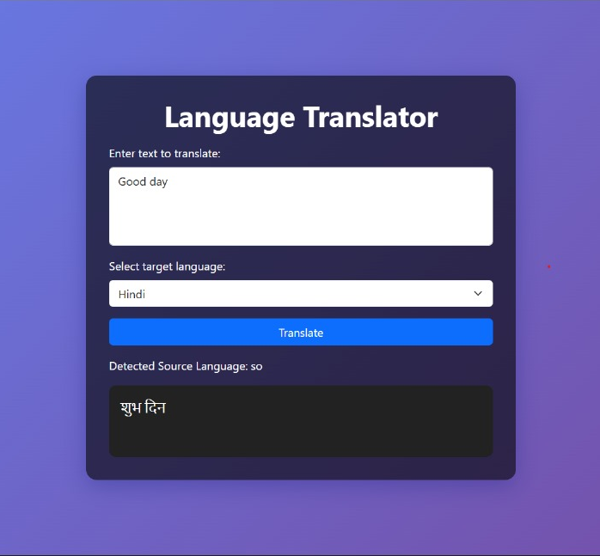
Objective of the Project
Create an efficient language translation system.
Provide an easy-to-use interface for real-time translation.
Enhance user experience by auto-detecting languages.
Build a scalable backend using open-source tools.
Notes:
Font Styles: Times New Roman + Font Size: 25

Slide 6
Technology Used
Frontend:
HTML
CSS
JavaScript
Bootstrap
Backend:
Flask (Python)
Hugging Face Transformers (MarianMT)
Langdetect (for language detection)
Notes:
Font Styles: Times New Roman + Font Size: 25

Slide 7
Modules
User Interface Module: Input area, target language selector, result display.
Translation Module: Handles source detection, translation logic.
API Module: /translate endpoint for backend communication.
Error Handling Module: Handles unsupported languages and bad inputs.
Notes:
Font Styles: Times New Roman + Font Size: 25

Slide 8
Workflow/Gantt Chart
User Flow:
User enters text
Selects target language
Translation request sent to backend
Backend detects language, translates, returns result
Result displayed in frontend
Notes:
Font Styles: Times New Roman + Font Size: 25

Slide 9
Reports
Project Documentation: Architecture, modules, code flow
Technical References: Flask, Hugging Face, Langdetect
UI/UX Design: Bootstrap principles
Model Info: MarianMT on Hugging Face
Future Scope: Add speech input, offline mode, caching
Notes:
Font Styles: Times New Roman + Font Size: 25

Slide 10
References
Hugging Face Transformers Documentation
Flask Framework Official Docs
Langdetect Library GitHub
Bootstrap UI Guide
Research papers on machine translation
GitHub repositories for MarianMT examples
Notes:
Font Styles: Times New Roman + Font Size: 25

Slide 11
THANKYOU

